Slide 1

Physical-Layer Exploits on EV Chargers: Authentication and Systemic Protocol Weaknesses
Hetian Shi, Yi He, Shangru Song, Zhenhao Tian,
Jianwei Zhuge and Jian Mao
Notes:
Good morning, ladies and gentlemen. My name is Hetian Shi from Tsinghua University. Today, I ‘m just going to share with you our work on “Physical-Layer Exploits on EV Chargers: Authentication and Systemic Protocol Weaknesses.”
This talk focuses on physical-layer attacks on charging guns, protocol weaknesses, and how attackers can exploit these flaws to manipulate EV charging behavior remotely.”

Slide 2
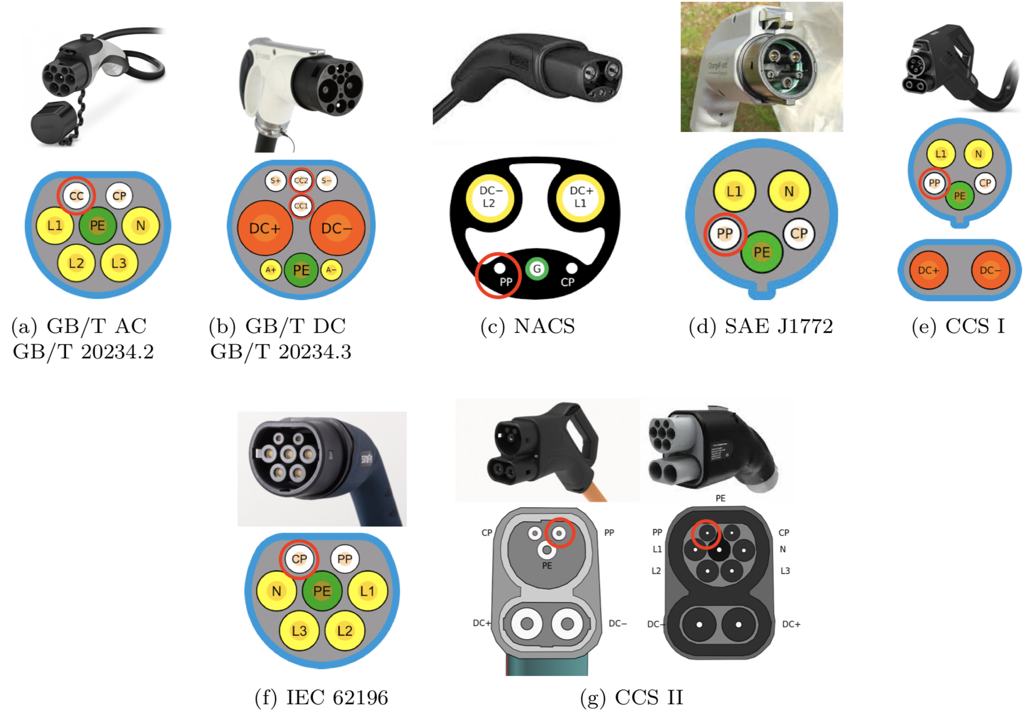
Background — Charging Gun Standards
Different Charging
Gun Standards
Notes:
To begin, here is the landscape of charging gun standards used around the world.
As you can see on this slide, EV charging connectors vary widely—GB/T, SAE J1772, CCS, IEC, and the newer NACS standard.
Even though the shapes and pin layouts differ, most of them share similar authentication circuits based on CC and CP ports.
This common design also means common weaknesses across ecosystems.

Slide 3
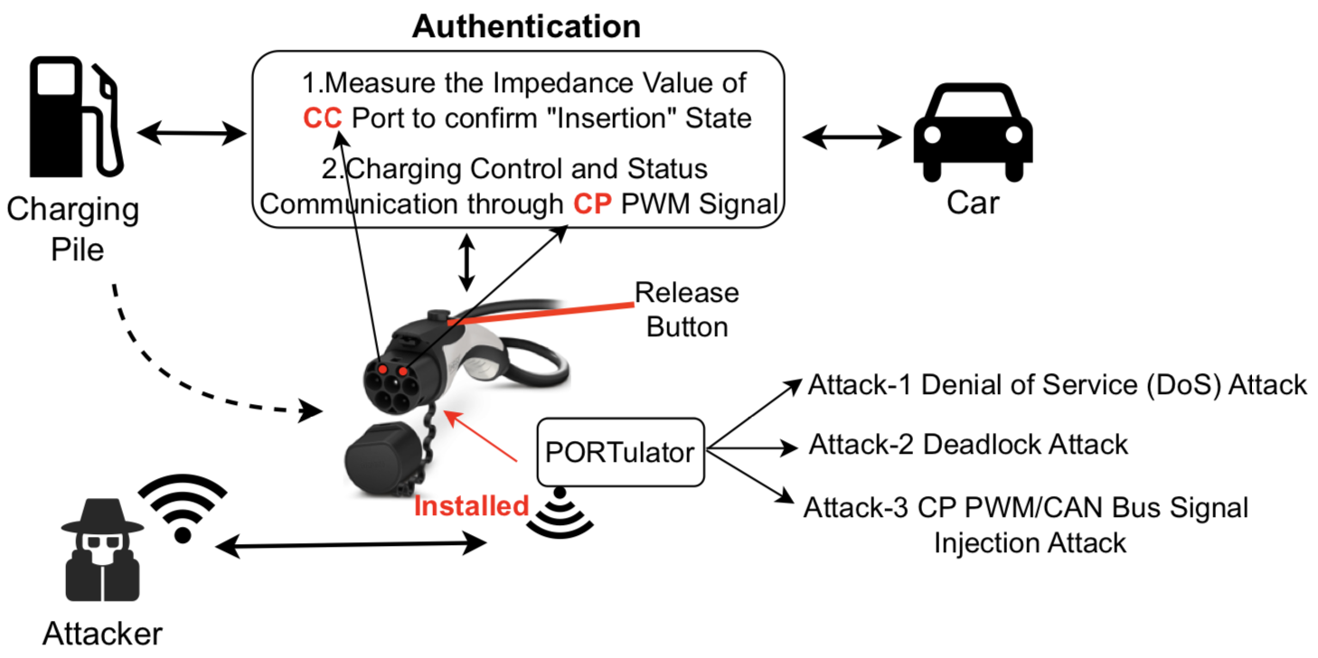
Background — Security Weaknesses in EV Charging System
The charging pile determines the connection authentication status through the Charging Confirmation (CC) port, vehicle identity verification via the Control Pilot (CP) port, and charging standard authentication.
Notes:
Most charging piles authenticate a connection using only simple electrical signals.
The CC port checks whether the gun is inserted, and the CP port provides PWM signals for charging control and basic handshake.
But these mechanisms are purely physical-layer and largely static.
This simplicity creates security blind spots—an attacker only needs to spoof resistance or PWM to deceive the pile and the vehicle.

Slide 4
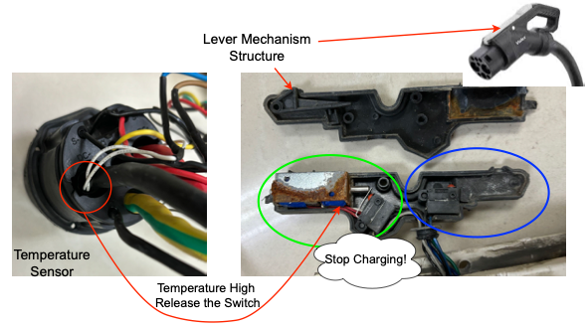
Background — Safety Measures
Notes:
Charging guns do have safety sensors, such as thermal protection and mechanical levers.
However, these measures only prevent overheating or physical damage.
They do not prevent spoofing of electrical authentication signals.
As a result, an attacker can bypass the intended safety logic without actually triggering the hardware protections.

Slide 5
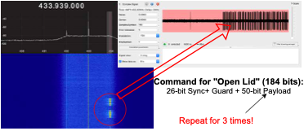
Preliminary — Unauthenticated Wireless “Open-lid” Commands
Notes:
Another interesting weakness is the wireless ‘open-lid’ command used by some charging piles, including Tesla, Li Auto, and so on.
This figure on the slide shows the Tesla control signal. It is a short 184-bit RF command transmitted repeatedly, with no authentication or pairing.
This means anyone with a low-cost RF transmitter can replay the command to open the charging port of the pile, as a preliminary for attacks to get access to the inner ports of the vehicle.

Slide 6
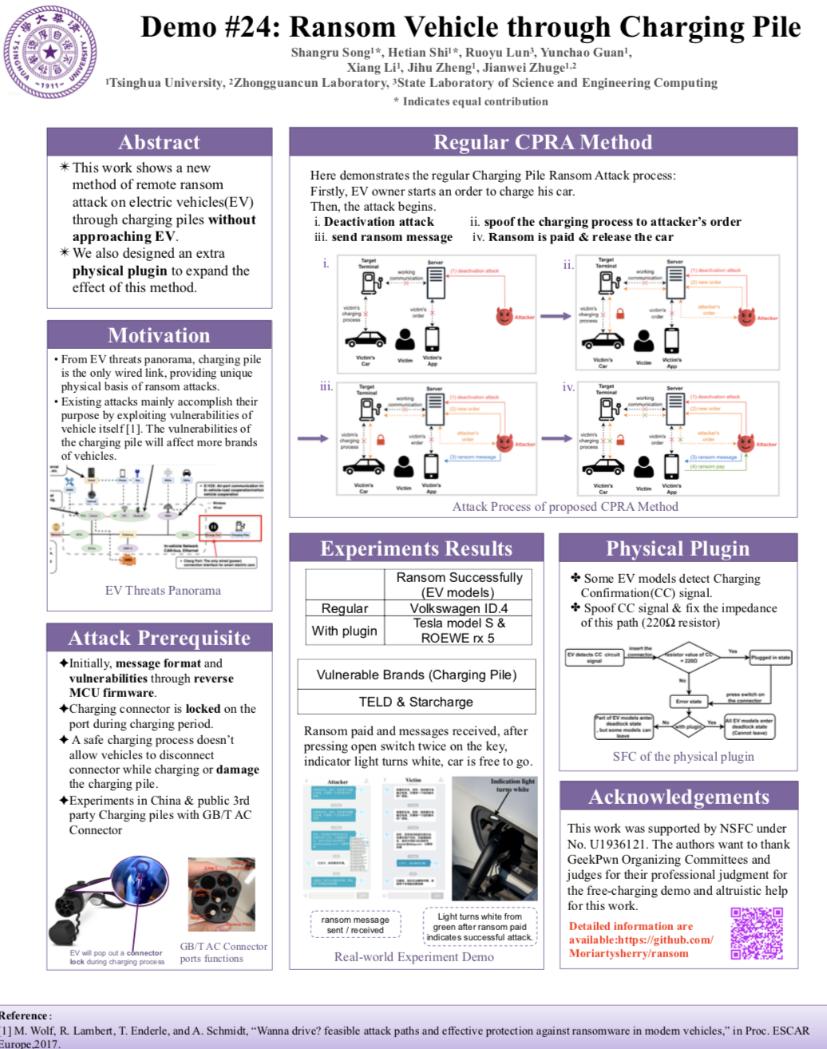
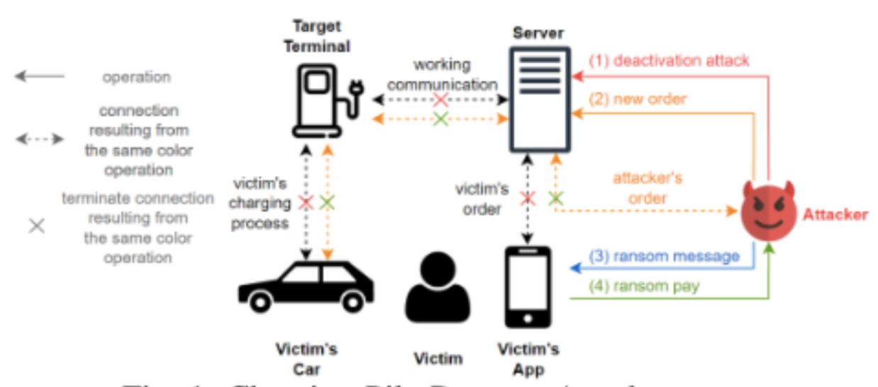
Motivation — Ransom Vehicle through Charging Pile
@ CPRA VehicleSec 2022
In the GB/T AC charging gun, we successfully performed charging gun connection status spoofing of the EV by falsifying the resistance value of the CC port.
Notes:
Our motivation came from a previous demo at VehicleSec 2022, where we showed that altering the CC resistance on GB/T AC guns can spoof the connection state.
This allowed us to trick the charging pile into thinking the gun was still inserted, effectively locking the vehicle or disrupting charging.
We wanted to explore how far such spoofing could go—and whether the problem was systemic across other standards.

Slide 7
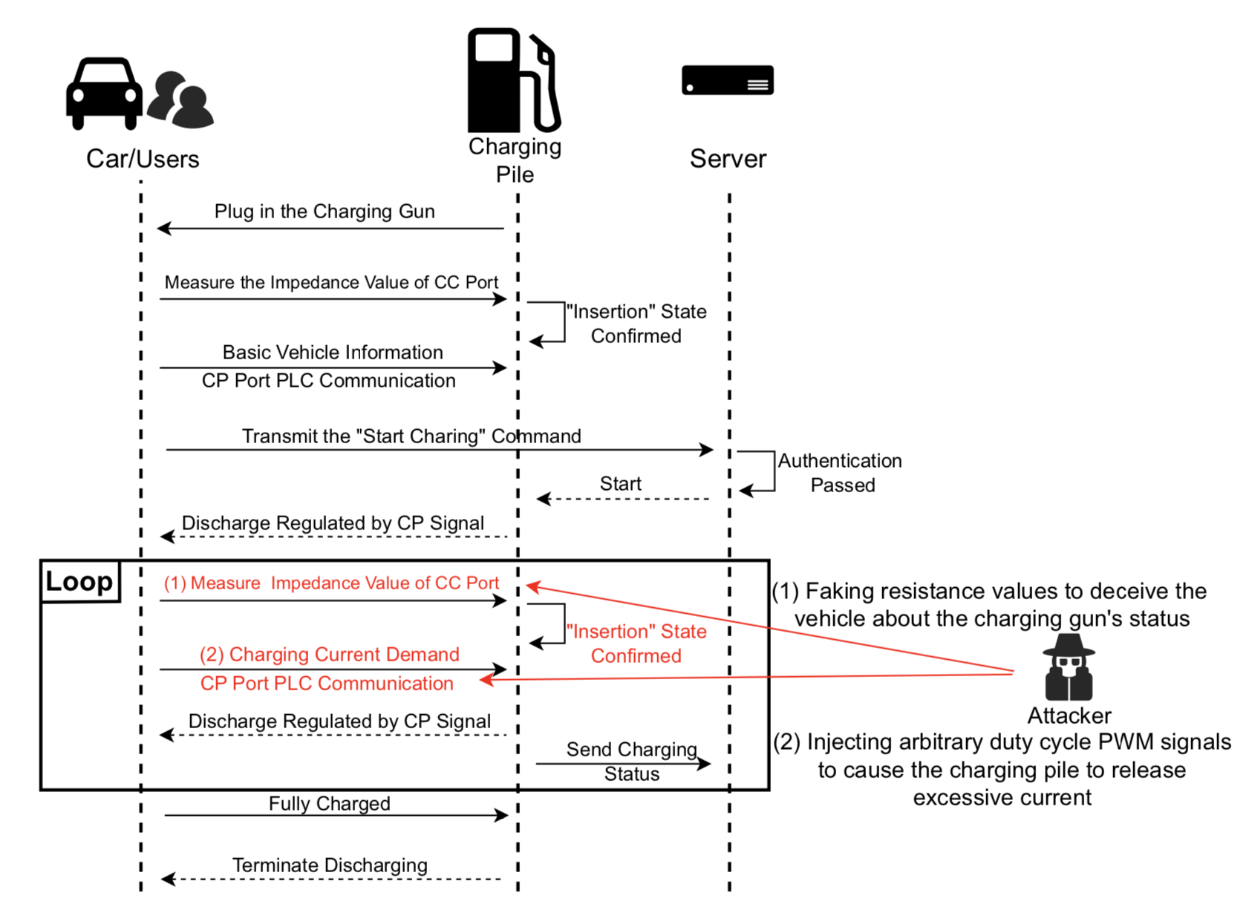
Overview — Weak Authentication in EV Charging Protocol
Notes:
This slide summarizes the problem. The charging process relies on two physical signals:
1) impedance measured on the CC line, and 2) PWM signals on the CP line.
Both signals can be easily forged. So in our threat model, the attacker injects fake CC or CP signals, bypasses authentication, and manipulates the charging state—while the pile believes everything is normal.

Slide 8
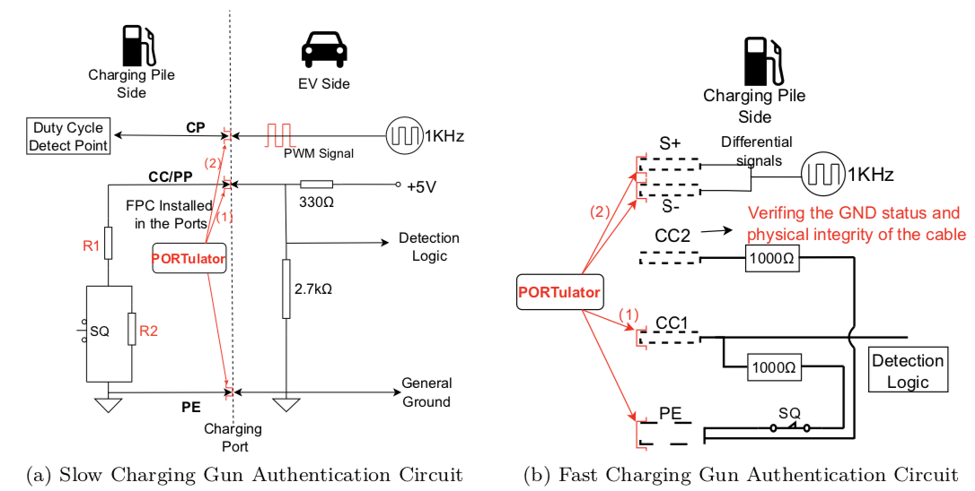
Authentication circuits of AC & DC Charging Gun
Notes:
Here you can see the actual authentication circuits.
AC charging uses a simple resistor ladder on the CC port, and PWM on CP.
DC fast charging adds differential signals but still heavily depends on fixed expected resistance values.
These designs were never intended to resist malicious interference—which makes them ideal targets for our exploit device.

Slide 9
Threat Model
1. Public Charging Piles Targeted: Attackers exploit public EV charging piles, which are easily accessible to anyone and commonly used by drivers who cannot install private chargers.
2. Physical Access Assumed: The model assumes attackers have physical access to the charging piles, allowing them to covertly install modified PORTulator devices.
3. Attack Execution: The PORTulator is discreetly integrated into the charging gun. When a user connects their vehicle, the attacker can send wireless commands to manipulate the charging process.
4. Potential Attacks: These include Denial-of-Service (DoS), locking the charging port, dangerous power discharge, and gaining access to the vehicle's CAN bus, which could immobilize the vehicle and damage critical systems.
Notes:
Our threat model is realistic:
Attackers target public charging piles, which anyone can access. We assume they have brief physical access—enough to insert a small modified device inside the charging gun.
Once installed, the attacker controls it remotely. This enables a wide range of attacks including DoS, deadlocking the port, forced discharging, and even injecting CAN messages into the vehicle through the charging interface.”

Slide 10
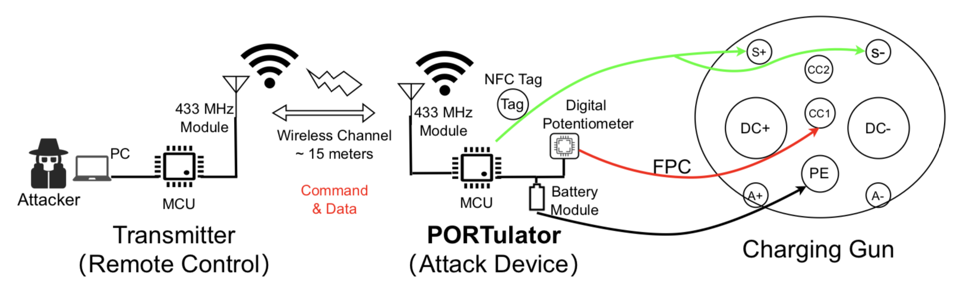
PORTulator Design
After deploying PORTulator on a public charging pile, the attacker can remotely control and launch attacks on the target vehicle via wireless signals.
Notes:
To demonstrate these threats, we designed PORTulator, a covert attack module.
It sits inside the charging gun and communicates wirelessly with the attacker.
Using digital potentiometers, MCU control, and RF command channels, it can generate arbitrary CC and CP signals, effectively impersonating any charging state.

Slide 11
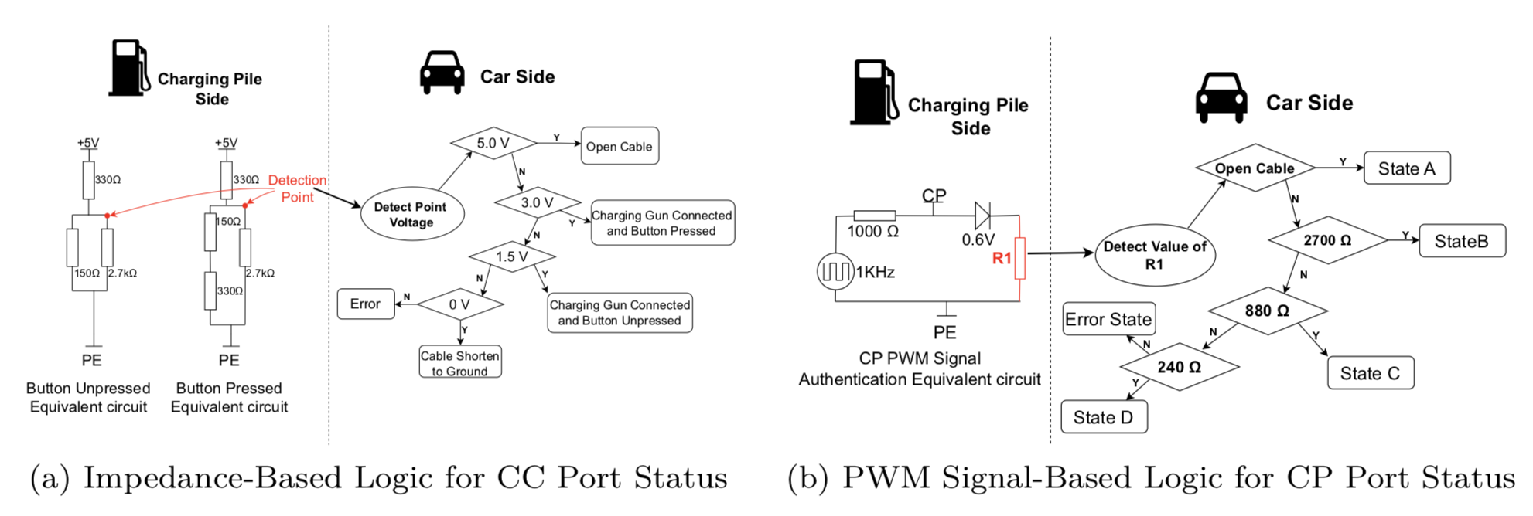
PORTulator Design — Signals to States
Notes:
On this slide we map physical signals to logical states.
By altering the CC impedance, we can simulate ‘button pressed’, ‘inserted’, or ‘error’ states.
By altering CP duty cycle, we control the advertised charging current or even inject fault states.
This gives full control over how the charging pile interprets the connection.

Slide 12
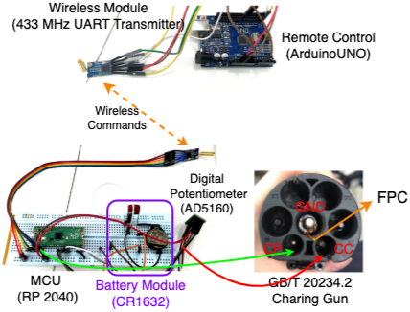

PORTulator Design — Devices
Notes:
Here you see our actual prototype.
We built a ring-shaped PCB so it fits inside commercial charging guns, including NACS and GB/T models.
The module includes RF receivers, MCU control boards, and an AD5171 digital potentiometer for CC spoofing.
It is disguised as a standard charging gun accessory, making it hard to detect.
In the future, we plan to update the design by using FPC (Flexible Printed Circuit) to create a black external circuit housing.
This will allow the module to be deployed on the charging gun without affecting its normal operation.

Slide 13
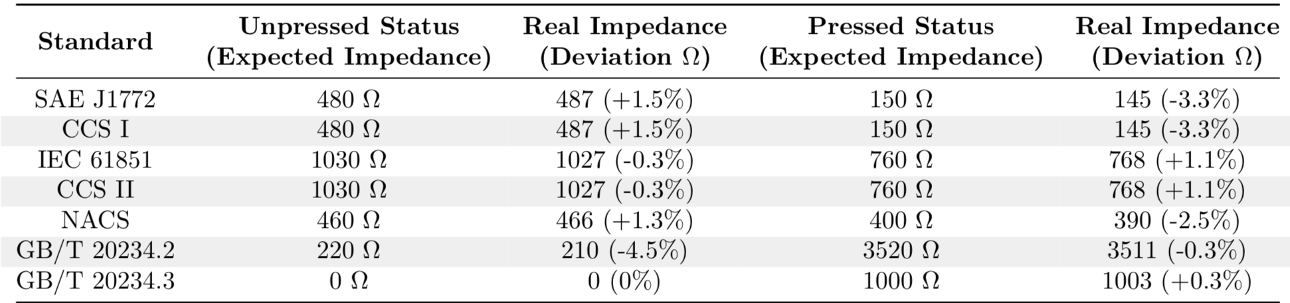
PORTulator Design — Control & Command Interface
PORTulator uses a digital potentiometer to detect the different resistance values of the CC port in various states.
PORTulator generates PWM signals with corresponding duty cycles through the MCU and CAN bus chip.
Notes:
These tables show impedance values defined by charging standards.
PORTulator dynamically adjusts resistance to match any of these values within tolerance.
It can also generate CP PWM signals following the target protocol.
Together, this enables precise manipulation of charging states across multiple global standards.

Slide 14
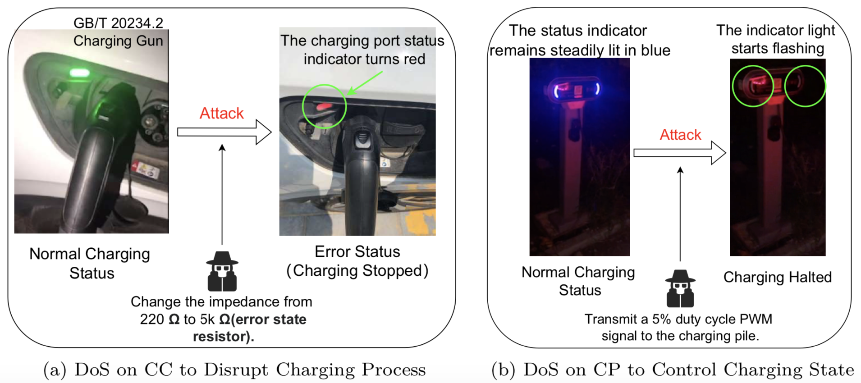
Case I — DoS Attack
Notes:
In the first attack, we perform a DoS by spoofing an error state.
By switching the CC resistance to an invalid value, the charging pile immediately stops the session.
Alternatively, by sending a 5% duty-cycle CP signal, we force the charger to halt current delivery.
Both methods instantly interrupt the victim’s charging.

Slide 15
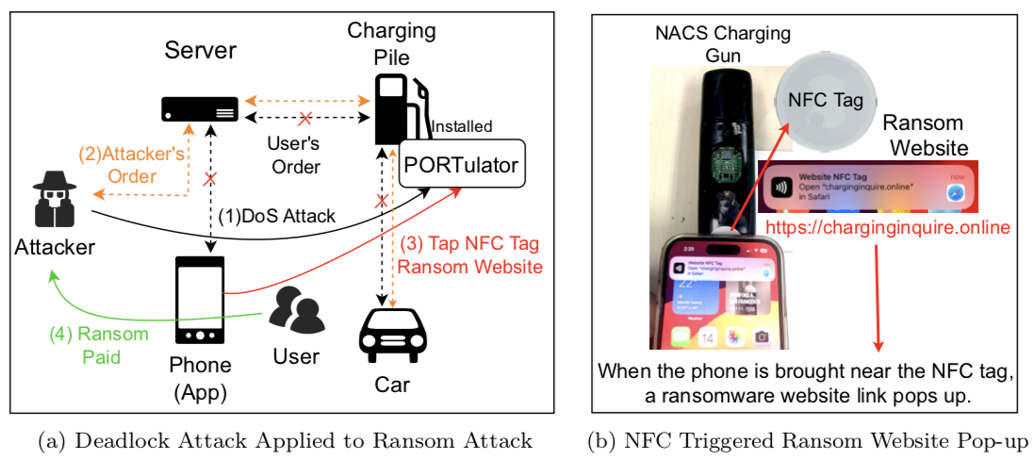
Case II — Deadlock Attack
Notes:
The second attack creates a deadlock.
We falsify CC signals so the vehicle believes the gun is still locked in place—even after the user tries to unplug.
To exploit this, we embed an NFC tag on the gun, showing a ransom webpage.
The user thinks their car is ‘locked’ and must scan the link to resolve it.

Slide 16
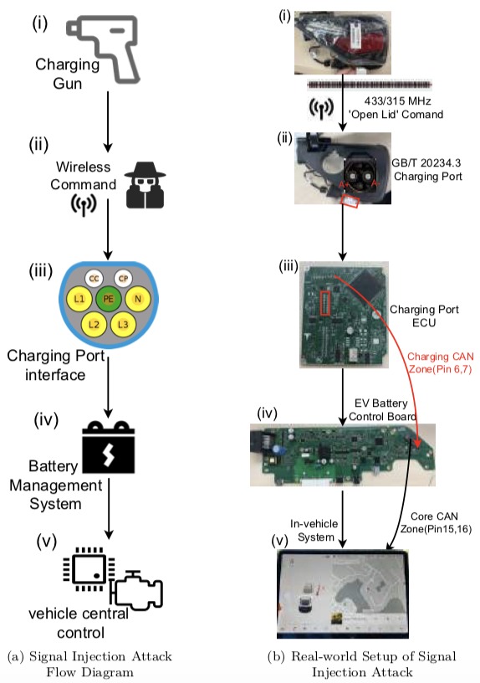
Case III — PWM/CAN Bus Signal Injection Attack
Notes:
The third attack escalates further.
By combining CP spoofing with CAN injection—possible on certain GB/T implementations—we manipulate the Battery Management System.
Our injected messages can change the charging current or command other unsafe behaviors.

Slide 17
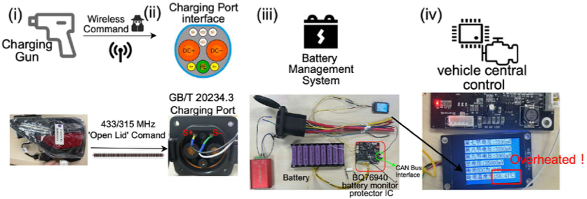
Case III — PWM/CAN Bus Signal Injection Attack
Notes:
Here comes to a real experiment.
We sent a wireless ‘open-lid’ command, then injected CAN frames into the BMS through the charging port.
As shown on the display, the battery module overheats due to manipulated charging parameters.
This demonstrates that charging ports can become a serious attack surface.

Slide 18
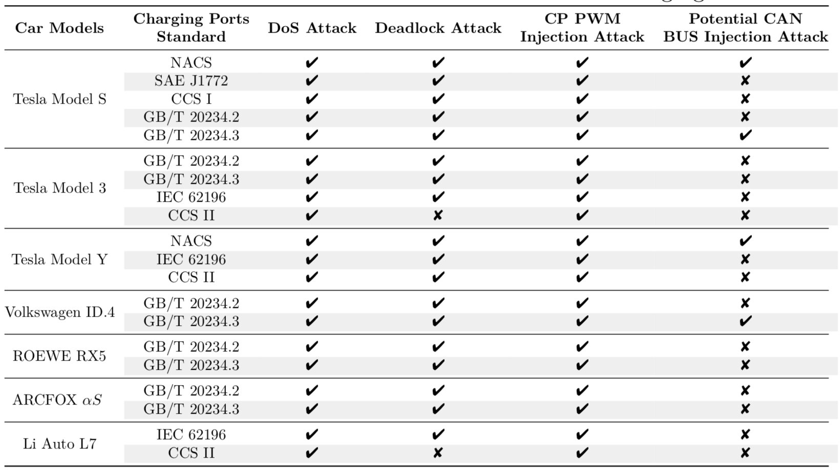
Attack Results
Notes:
We tested multiple EV models and charging standards.
Most vehicles were vulnerable to at least one attack type, and several accepted both CP and CC spoofing.
Some models even permitted partial CAN injection.
This confirms that the weaknesses are widespread across the ecosystem.

Slide 19
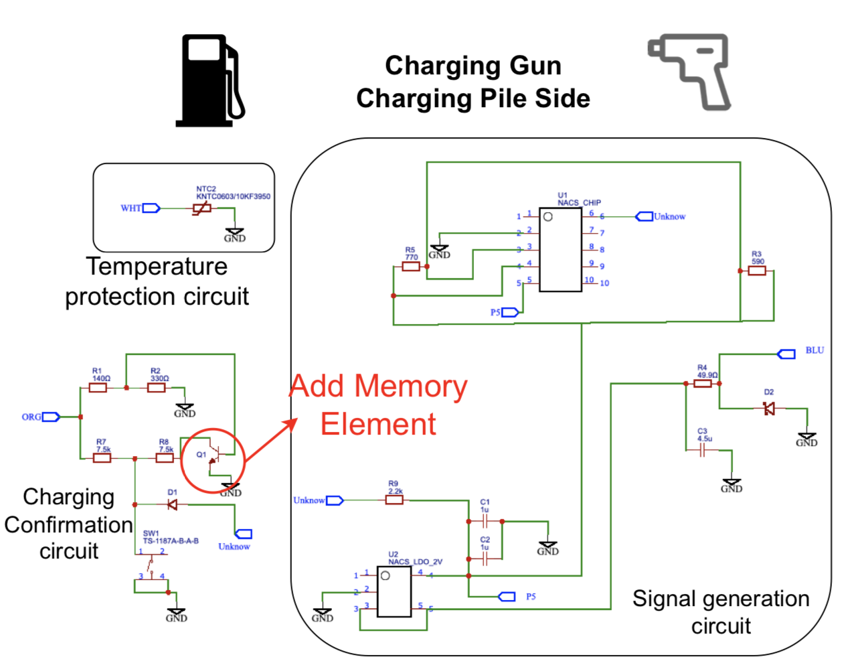
Mitigation
Add Memory
Electric Element
Notes:
To defend against resistance spoofing, we propose adding memory-based electronic elements in the charging gun.
These elements introduce stateful behavior that cannot be replicated by a simple digital potentiometer.
Thus, attackers cannot easily mimic valid CC transitions.

Slide 20
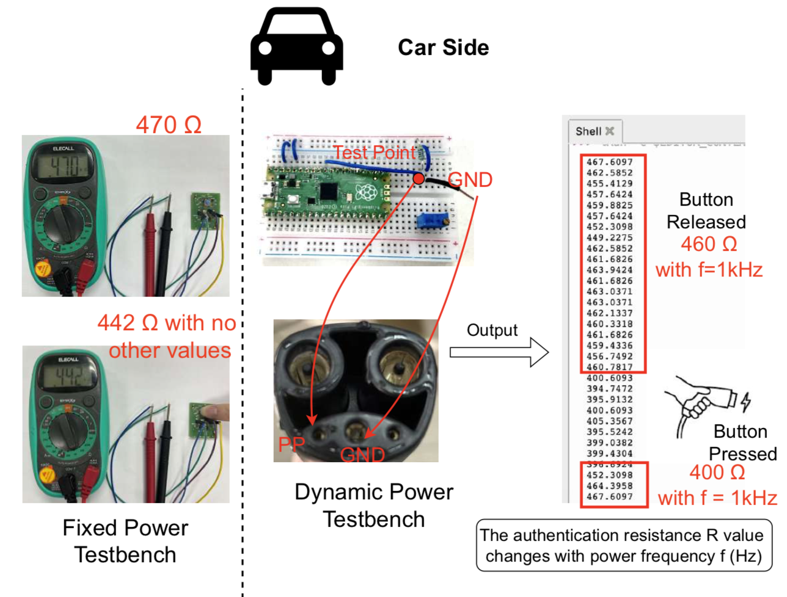
Mitigation
Utilizing Dynamic
Power Source
Notes:
Our second mitigation uses dynamic power sources for authentication.
Instead of fixed resistances, the charging gun varies the CC impedance based on a modulated source.
As you see here, the authentic resistance differs under button-released and button-pressed states with a 1 kHz modulation.
Static spoofers cannot reproduce this behavior accurately.”

Slide 21
Future Work
Broader Testing: Extend the PORTulator attack suite to more charging systems.
Real-World Testing: Conduct experiments under real-world conditions, including varying network loads and environmental factors.
Battery Protection Mechanisms: Investigate methods to bypass or counteract vehicle Battery Management System (BMS) safeguards that prevent overheating and damage from attacks.
Notes:
In our future work, we plan to extend testing to more charging ecosystems, evaluate attacks in diverse environmental conditions, and analyze how BMS systems respond to more sophisticated spoofing.
Understanding BMS failure modes will be especially important for preventing thermal damage or unsafe current flows.”

Slide 22
Conclusion
Vulnerabilities in Authentication: Significant weaknesses were found in the authentication mechanisms of widely adopted EV charging protocols, allowing for potential security risks.
Remote Manipulation Feasibility: The study demonstrated that remote manipulation of charging operations is possible through attack vectors such as signal injection and manipulation of CP and CC ports.
Inadequate Security in Current Protocols: Existing authentication protocols (GB/T 20234, IEC, SAE J1772, NACS, CCS) are insufficient against sophisticated spoofing attacks, particularly those based on static resistance.
Proposed Countermeasures: Suggested solutions include enhancing authentication with dynamic power, memory electric elements, and multi-layer security checks to mitigate these vulnerabilities.
Notes:
In conclusion, we uncovered fundamental authentication weaknesses in EV charging protocols.
Because CC and CP rely on static physical signals, attackers can easily manipulate them to disrupt charging, lock vehicles, or even inject CAN messages.
We demonstrated that remote, covert manipulation is feasible using a device like PORTulator.
Finally, we proposed dynamic and memory-based electrical defenses to make these attacks substantially harder.

Slide 23

Thank you for your listening！
Authors: Hetian Shi, Yi He, Shangru Song,
Zhenhao Tian, Jianwei Zhuge* and Jian Mao
Jianwei Zhuge is the corresponding Author.
E-mail: zhugejw@tsinghua.edu.cn
Acknowledgement: This work was supported in part by the National Natural Science Foundation of China (NSFC) under Grant No. 62572266. We thank anonymous reviewers for their comments to improve the paper.
Website: https://github.com/Moriartysherry/ev-charging-station-security
Notes:
Thank you for your attention. For more information, please scan the QR code to visit our program website.

